Slide 1
MALL CUSTOMERS SEGMENTATION
Presented by:
Kushal SINGH Ramgadiya

Slide 2
PROJECT INTRODUCTION
Customers who come for shopping in a mall can be grouped in a number of ways. Shopping patterns, spending patterns, shopping scores, salaries, etc. are some of the factors that can be used to divide the customers into different categories.
The reason for these clusters is to help identify those customers who would be interested in certain products, offers, and services.
To create a Customer cluster to identify the different types of customers

Slide 3
PROBLEM STATEMENT
To create a Customer Cluster to identify the different types of customers.

Slide 4
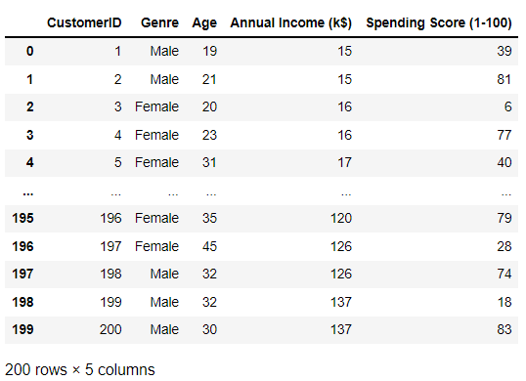
DATA SOURCE
This data set is provided by NIIT. It contains 200 samples and 5 features
We use unsupervised machine learning algorithms in this analysis since there are No labels over the data.

Slide 5
DATA TREATMENT
No null values
No duplicate values
No outliers

Slide 6
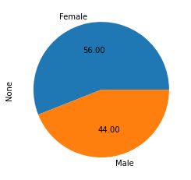
EXPLORATORY DATA ANALYSIS(EDA)
There are 200 Customers, Male = 88, Female = 122
Both the count and pie chart show that there are more females than male customers.

Slide 7
From this table we can conclude that females spend slightly more than males.
Gender | Spending Score
Female | 51.526
Male | 48.511

Slide 8
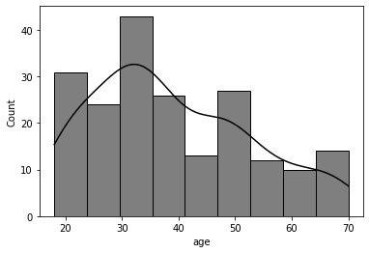
From this histogram plot we can see that most of the customers are between the ages of 25 to 40 years.

Slide 9
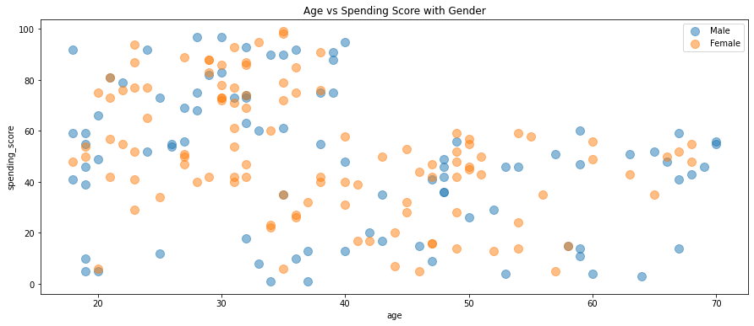
From this scatterplot it shows that the younger people tend to spend more.

Slide 10
FEATURE SELECTION
From the exploratory data analysis above, it is obvious that all the variables have some sort of relationship with SPENDING SCORES.
We will be using all the variables to build the clustering models.

Slide 11
FEATURE TRANSFORMATION
Since the Gender column datatype is categorical, then we have to convert it into a numerical datatype using the one-hot encoding (pandas.get_dummies).
After this we’ll be choosing the Annual Income and Spending Score column.

Slide 12
CHOOSING THE NUMBER OF CLUSTERS
WCSS >> Within Clusters Sum square
WCSS is the sum of the squared distance between each point and the centroid in a cluster.
When we plot the WCSS with the K value, the plot looks like an Elbow.
As the number of clusters increases, the WCSS value will start to decrease.
WCSS value is largest when K = 1.

Slide 13
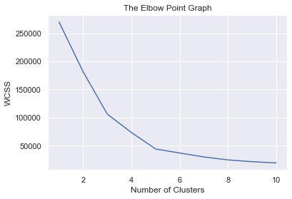
After plotting the Elbow Graph we found the optimum number of clusters is equal to 5.

Slide 14
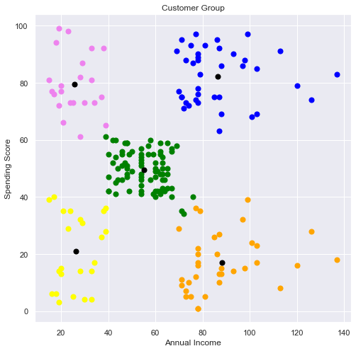
K-means CLUSTERING
Cluster 1: Earning less but Spending more.
Cluster 2: Average in terms of earning & spending.
Cluster 3: Earning high and Spending high as well.
Cluster 4: Earning more but Spending less.
Cluster 5: Earning less & Spending less
Black Dots are Centroids.

Slide 15
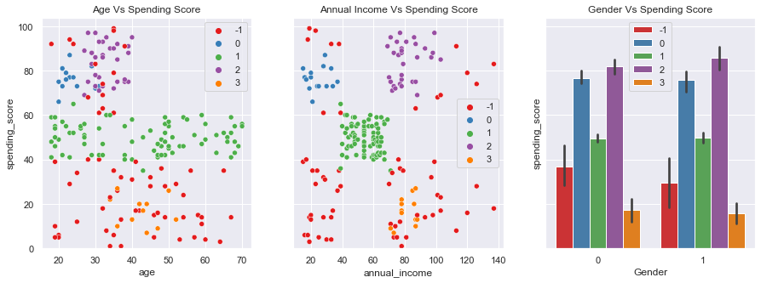
DBSCAN CLUSTERING
Similarly, DBSCAN also shows that Age is the most important factor to consider as younger people spend more irrespective of their Annual income.

Slide 16
SILHOUETTE COEFFICIENT
From the models performance and evaluation using silhouette coefficient values for K-means and DBSCAN are
The silhouette score is: 0.44424291275274114
The silhouette score is: 0.20473300000169162
K-Means Clustering performs better than DBSCAN Clustering.

Slide 17
CONCLUSION
From the analysis we saw that younger people aged between 20 to 40 patronize the products and services more than older people.
The business should target Ads on this population, as they will get higher turnover and conversion rates.
It is also seen that female customers are slightly more than male customers, and they spend more even if their annual income is less than $50k.
This may represent a very desperate group, that needs the products more.
This is an area the business should obtain more data on for further analysis.

Slide 18
We can give better discounts and offers to these customers whose income is less and who are spending less. (yellow group)
We can also give an offer to the customers whose income is higher but they aren’t spending more, they can be an asset to the mall if they spend some more money. (orange group)

Slide 19
THANK YOU

